Slide 1
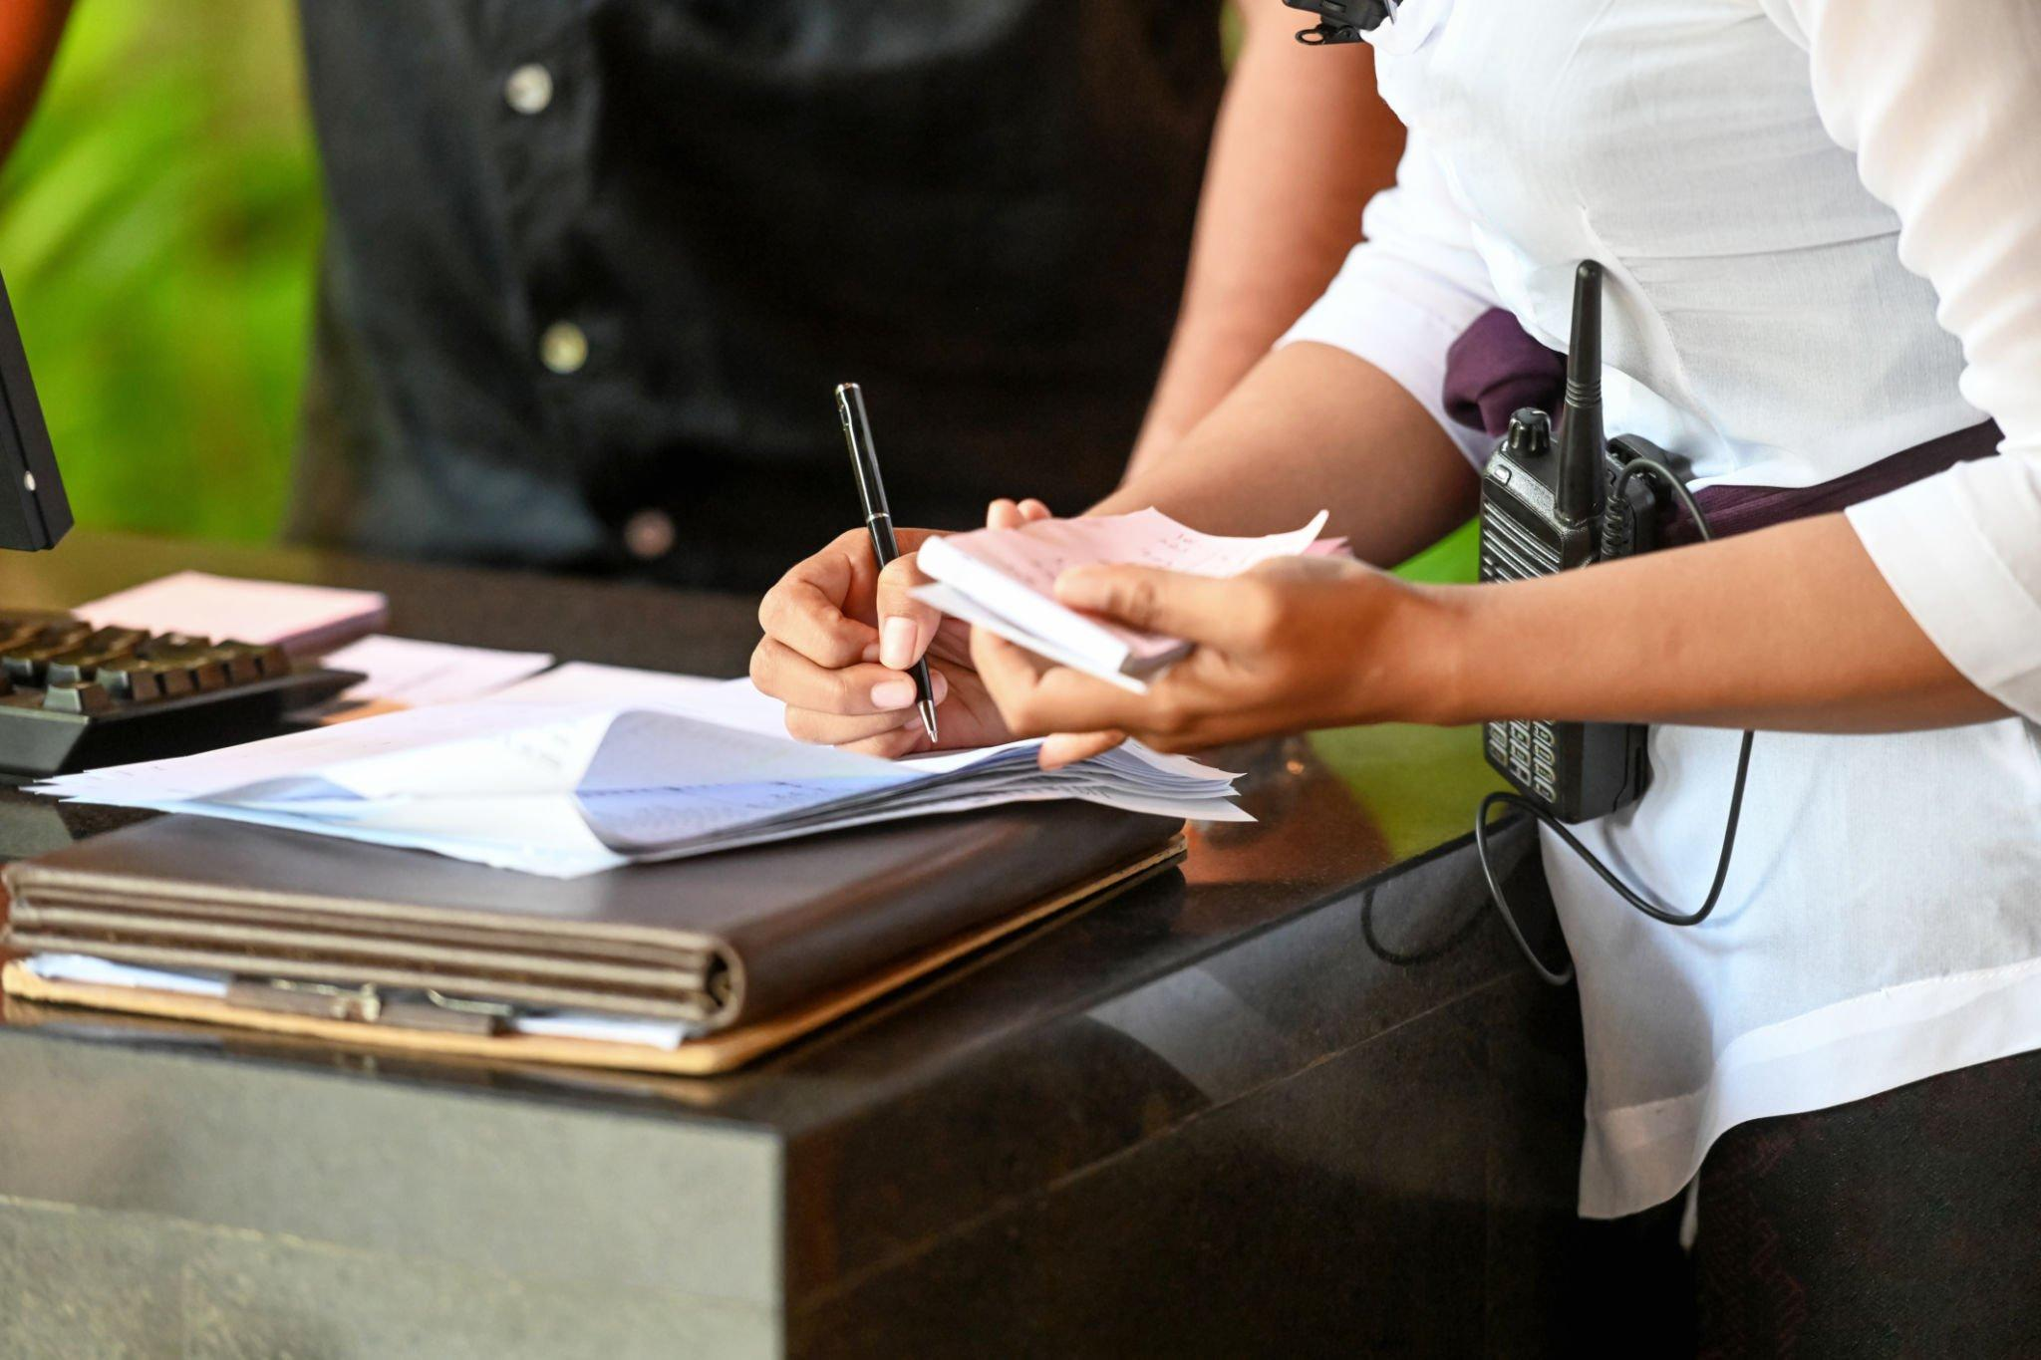
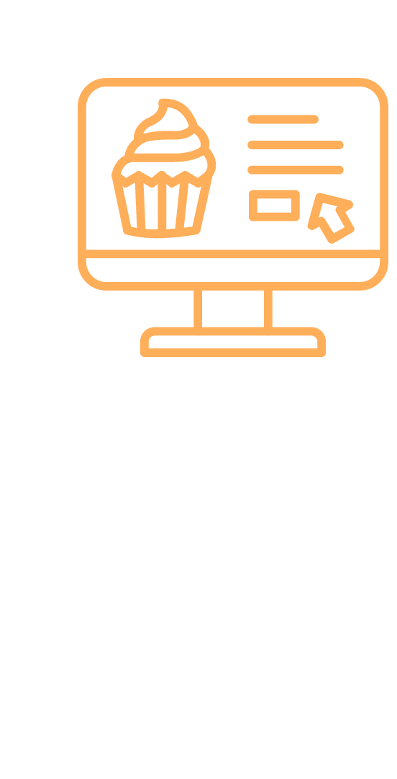
Cafeteria Billing & Ordering System
For Yummy Cafe
Shubha Khadgi

Slide 2
Introduction to the Organization
Yummy Café is a well-established catering company that has been providing cafeteria services to multiple institutions and organizations.
It currently serves KIST College of Management, Padmakanya Multiple Campus, and Prime CA College, among others.
At KIST College, the cafeteria has a team of 10 to 15 employees providing services to the institution.

Slide 3
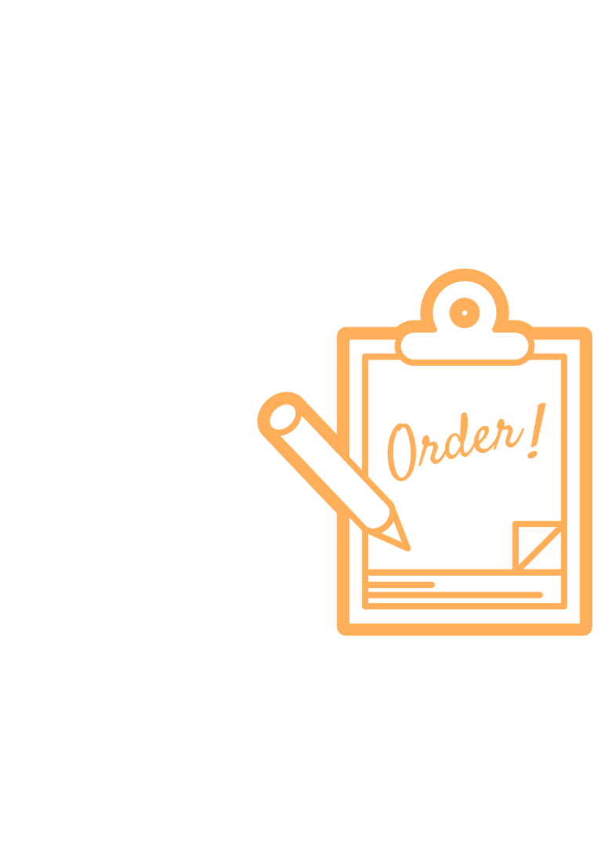
Current Situation
Yummy Café currently operates using an all-manual system.
This involves cash transactions and manual calculations in all operating colleges.
Resulting issues include long waiting queues, billing inaccuracies, and customer dissatisfaction.
Excel sheets are used for total sales and revenue calculations.

Slide 4

Problem Statements
Difficulty in Maintaining Records
Manual Billing and Payment Processes
Manual Inventory Management
Inefficient Cost Management
Inadequate Forecasting and Budgeting

Slide 5

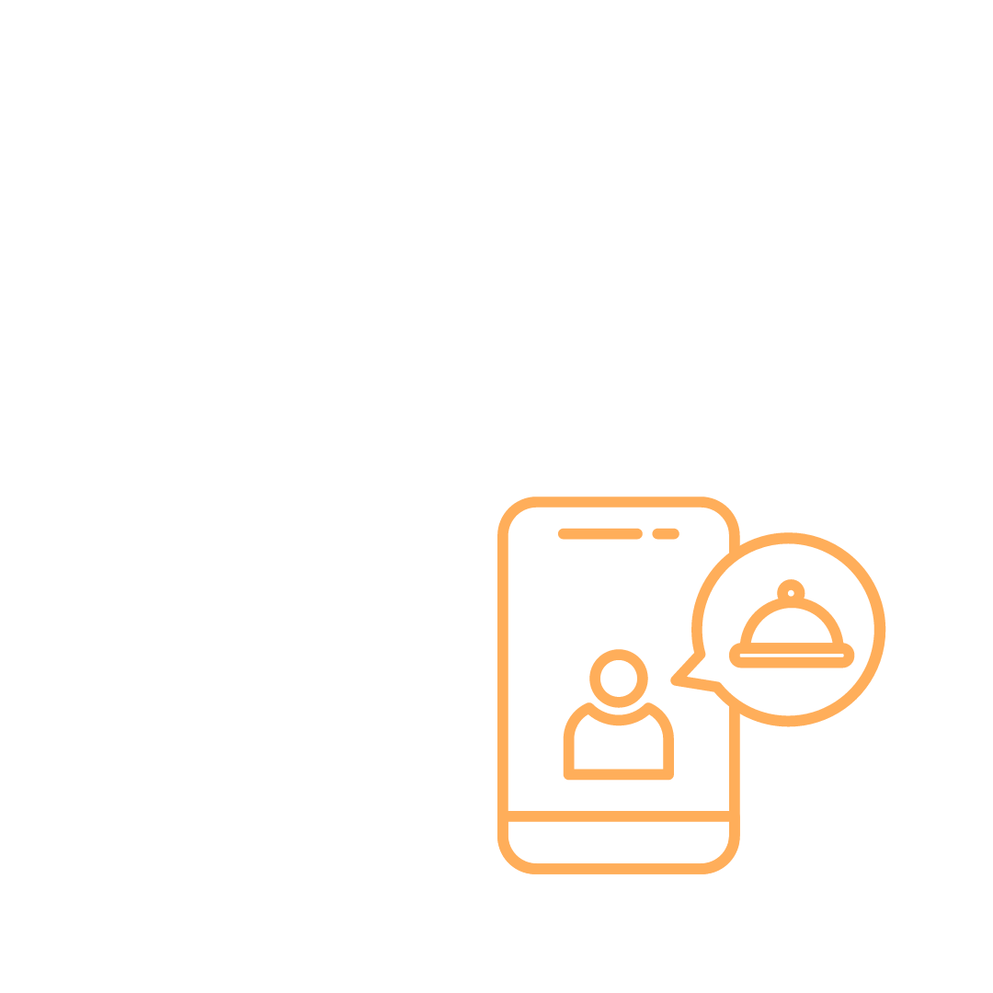
Objectives
General Objectives
Reducing Paperwork
Reducing Operational Time
Increasing Accuracy and Reliability
Maintaining Customer Satisfaction
Specific Objectives
Developing an Easy-to-Use Website
Computerized Customer Records
Online Menu and Ordering
Reducing Waiting Queues

Slide 6
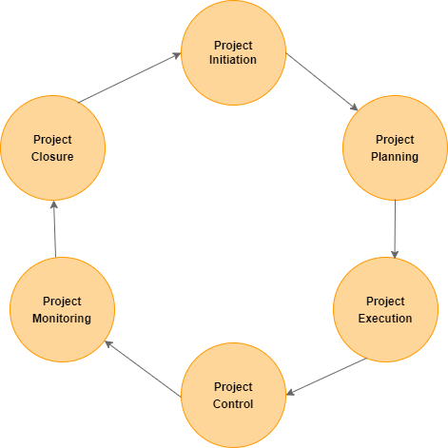
Methodology
Methodology refers to the systematic and structured approach used to conduct a study, investigation, or project.
For this project, the following framework was used:

Slide 7
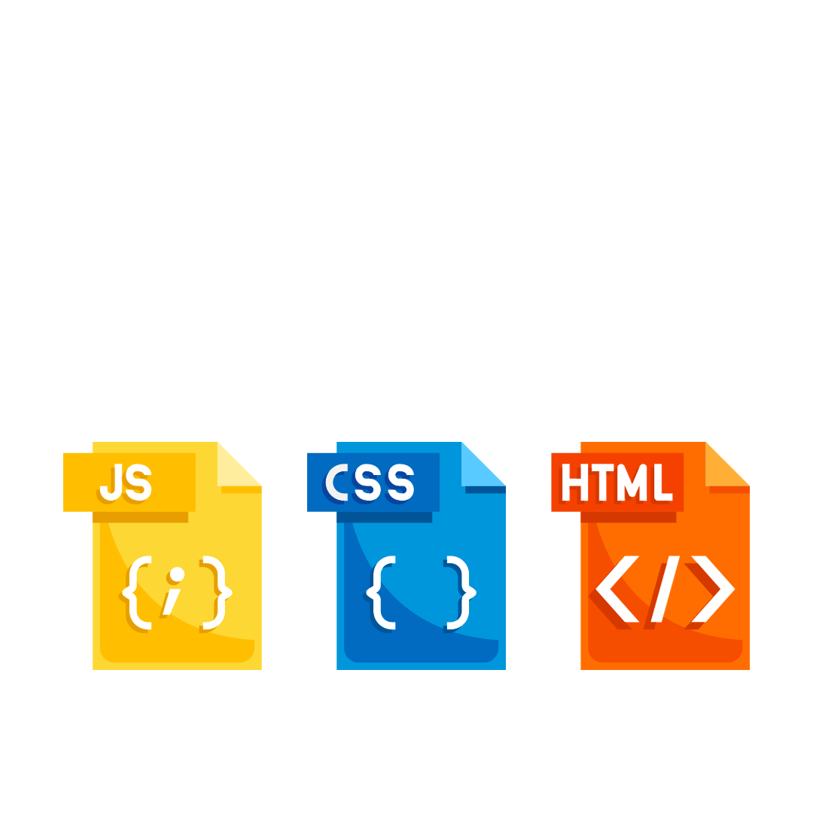

Methodology (Contd..)
Data and Information collected by :
Observation
Interviews
Research
Tools Used for project:
Laravel
phpMyAdmin
XAMPP Server
VCS (Git)
Visual Studio Code
HTML/ CSS/ JS

Slide 8
Feasibility Study
Operational Feasibility : The system should be easy for staff to use and help them do their jobs better.
Technical Feasibility : Check if it's easy to get the stuff needed for the system, like equipment and software.
Economic Feasibility : Figure out if the project makes financial sense by looking at the costs and benefits.

Slide 9

Requirement Analysis
Functional Requirement
User can log in
User can track their order status
User can select payment method
Manager can perform basic CRUD operation
Manager can view reports
Non-Functional Requirement
Maintainable, Available, Reliable, Usable

Slide 10
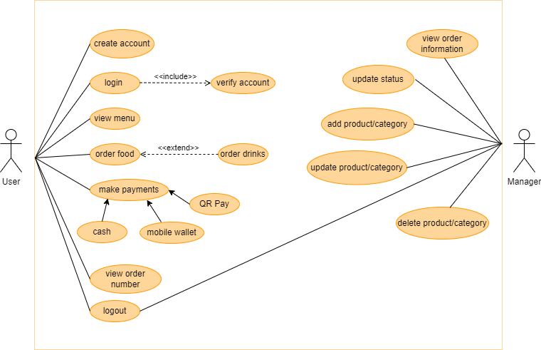
System Modeling
Use Case Diagram
It shows how a system interacts with its users

Slide 11
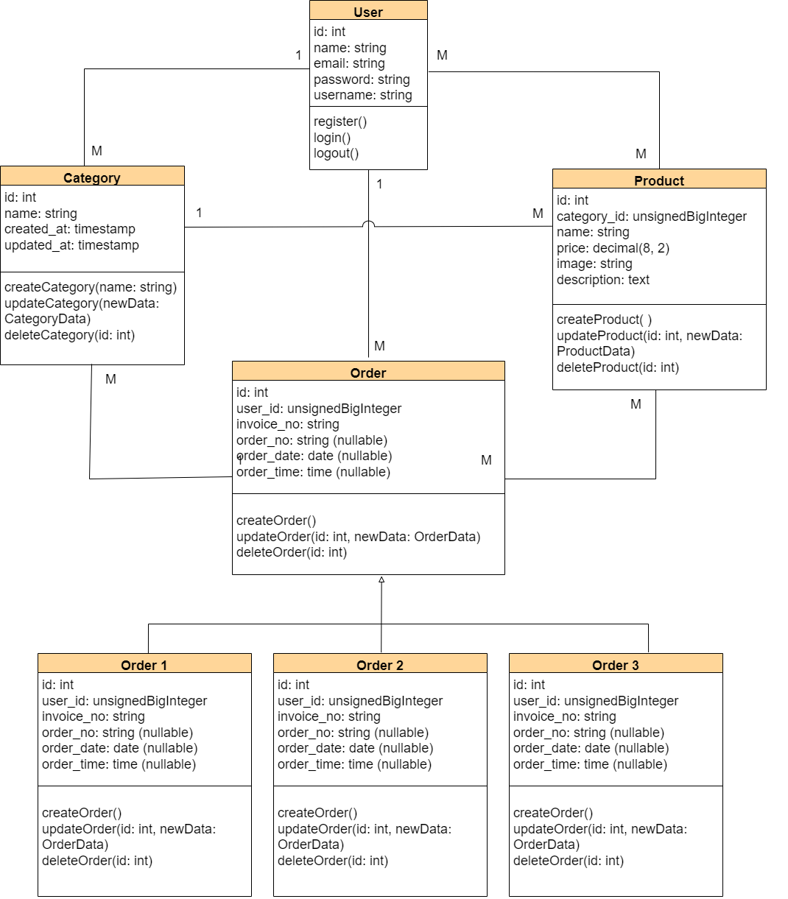
System Modeling
Class Diagram
It helps in designing and organizing the structure of a system

Slide 12
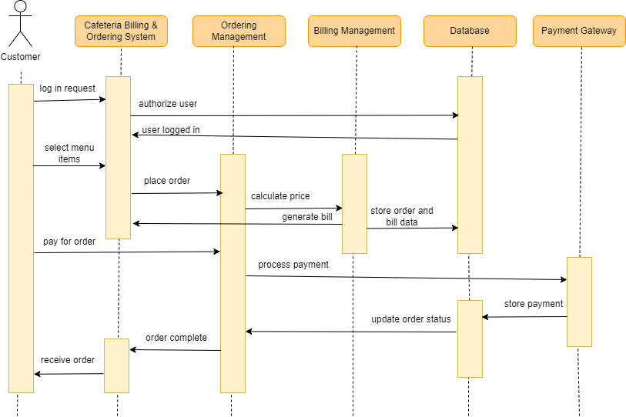
System Modeling
Sequence Diagram
It helps to understand and visualize the interactions and timing between different parts of a system, during execution.

Slide 13
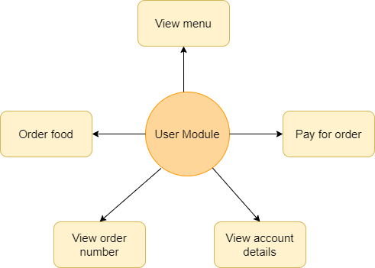
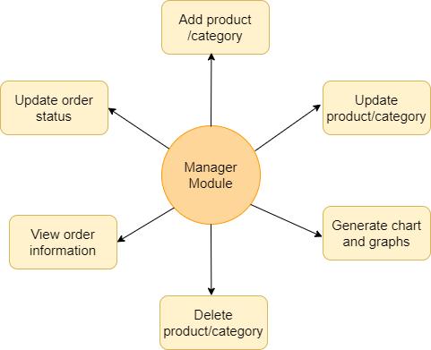
System Design
System design is the process of creating a detailed plan or blueprint for how a system will be built and function.
User Module
Manager Module

Slide 14
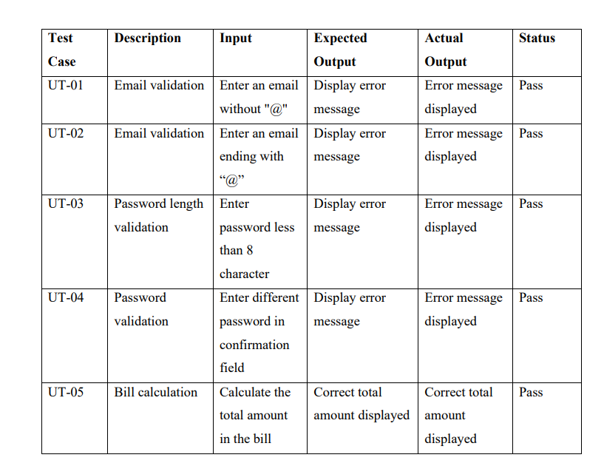
System Testing
Unit Testing
Focuses on testing the smallest building blocks of a software application, which are usually individual functions or methods.

Slide 15
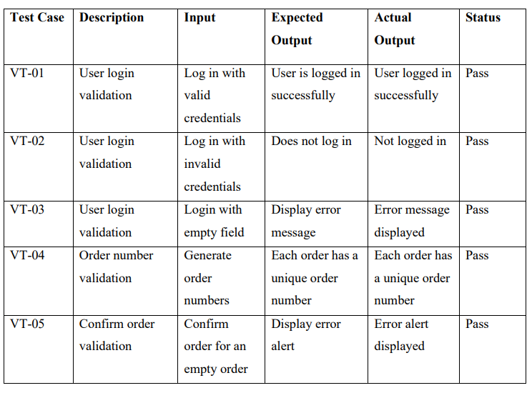
System Testing
Validation Testing
It is the process of determining whether the system satisfies the specified requirements

Slide 16
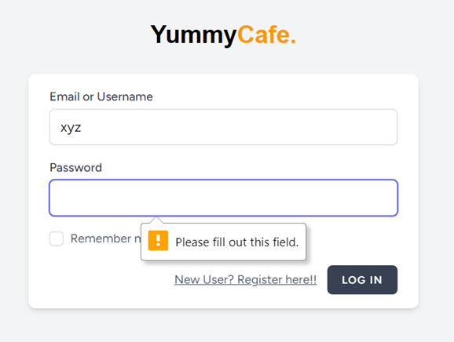
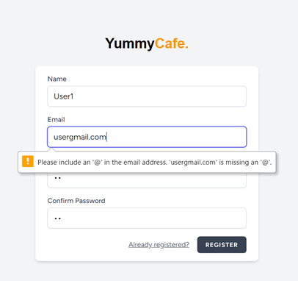
System Testing (Snapshots)

Slide 17
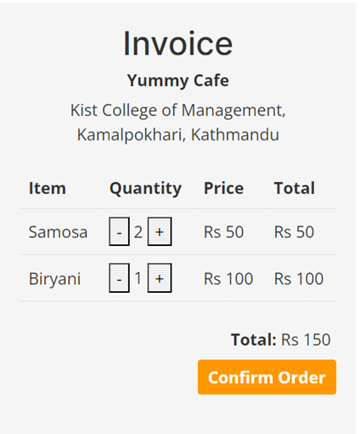
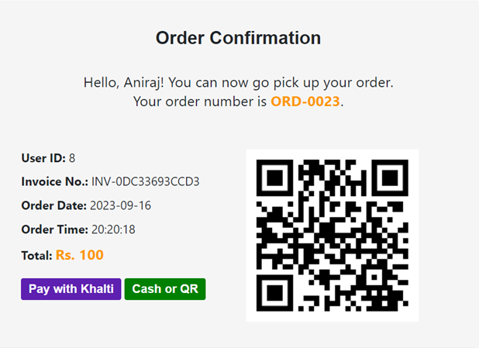
System Testing (Snapshots)

Slide 18

Future Enhancement
Menu Personalization
Integration with Inventory Management System
Mobile Application

Slide 19
Conclusion
"Cafeteria Billing & Ordering System" solves problems like long lines and mistakes in bills. However, it's important to know that it is still a work in progress.
The system is designed with user-friendliness in mind, featuring an integrated online payment gateway for convenience.
For the management, it offers operational efficiency along with sales reporting and analytics.

Slide 20
Video Demonstration

Slide 21
Any Queries ?

